Slide 1



Console App
Banking System

Slide 2
CONTENT
3. Python and it’s Implementation 4. Project Overview 5. Scope of the Project 6. Aim of the Project 7. Data Flow Diagram 10. Class Diagram 11. Functional Requirement 12. System Requirement 14. Operating Environment 15. Summary

Slide 3

Python and it’s Implementation
High-level programming language
environment which provides support for the execution of programs written in the Python language
C and Python, CPython is the default and most widely used implementation of the Python language

Slide 4
Overview
This Bank Operation System Project in Python is a easy console based project that’s very clean to understand and use. Talking approximately the gadget, it contains all of the basic functions which consist of creating a new account, view account balance, withdraws and deposit amount. Banking system in python is a simple and totally console-based application and developed using python programming language. The Banking Operation System is a Console-Based Application that allows users to perform various banking activities such as account management operations like Deposit, Withdrawal, Fund Transfers, Balance Enquiry.

Slide 5

SCOPE OF PROJECT
The scope of the Online Banking System project includes the following functionalities: Account management Create Account Deposit Amount Withdraw Amount Fund transfers between accounts. Saving Account Current Account Balance Inquiries. Available balance check Insufficient balance check

Slide 6
Aim of the project
To allow bank user to create new bank account in very convenient way. To make easiest way to use all functionalities present in the application Locate any account wanted by the user. To reduce many pen and paper use because it totally computer based system. Provides greater speed and reduce time consumption.

Slide 7
Data flow Diagram of the system modules
Account Opening
Account History
Banking System
Money Transfer
Balance Inquiry

Slide 8
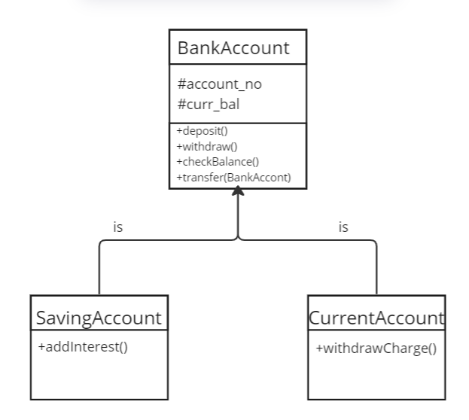
Class Diagram

Slide 9
Functional Requirements
Customer can request balance check n number of time on any account i.e saving , current Customer can make fund transfer from one bank account to another. Customer can view account balance. Customer can withdraw balance from his bank account. Customer can view remaining account balance.

Slide 10
System Requirements
Software Requirement Programming Language : Python Operating system : Windows Development tool : PyCharm – The Python IDE Hardware Requirement Ram : 1GB HDD Capacity : 100GB

Slide 11
Requirement ID | Requirement CATEGORY | Requirement TYPE | PRIORITY | HIERARCHY | REF
R001 | FUNCTIONAL | STATED | HIGH
Requirement DESCRIPTION | Windows OS, PyCharm
SCOPE | Showing balance , Deposit money, Withdraw money, Getting interest and Transfer money from one account to another account.
METHODOLOGICAL DETAILS of Requirement | Create a class named Bank_Account. Create method in class like Deposit(), Withdraw(), ShowBalance(), Transfer() The money should be consistent through out the whole process Deposited and withdrawal money should be reflected In that account Create base class as SavingAc and CurrentAc Create methods as Interest() and currentAcWithdraw()

Slide 12

OPERATING ENVIRONMENT
01
02
3
04
Windows PyCharm IDE
Mac-OS PyCharm

Slide 13
SUMMARY OF APPLICATION
In this mini project, there may be no such login device. User will be able to use all those available functions without problems without any restriction. It is too easy to use , user will test the total bank account facts without problems. This console application is developed for making easy use of the main functionalities of the bank. Using this console base app one can easily create bank account, check account balance and withdraw ac balance.

Slide 14

THANK YOU
By : Bhaktaram Kalindar
Emp Id : 200249

